Slide 1
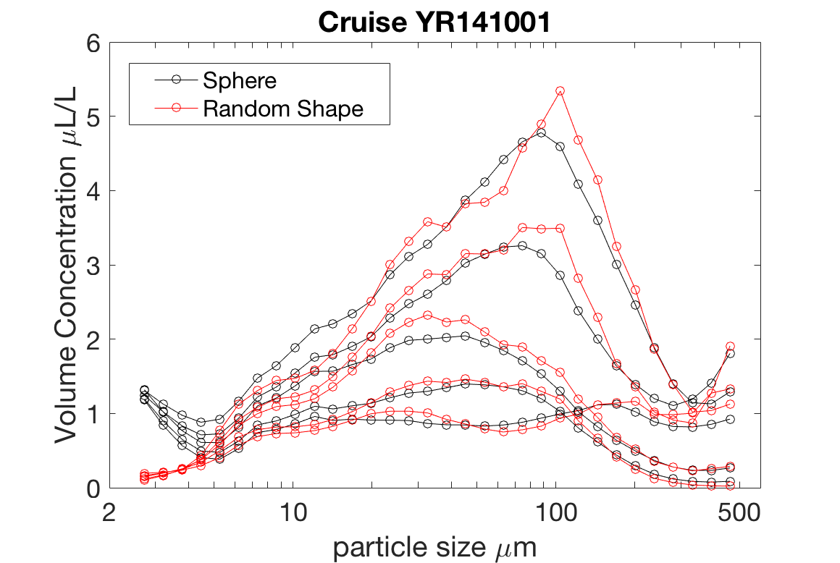
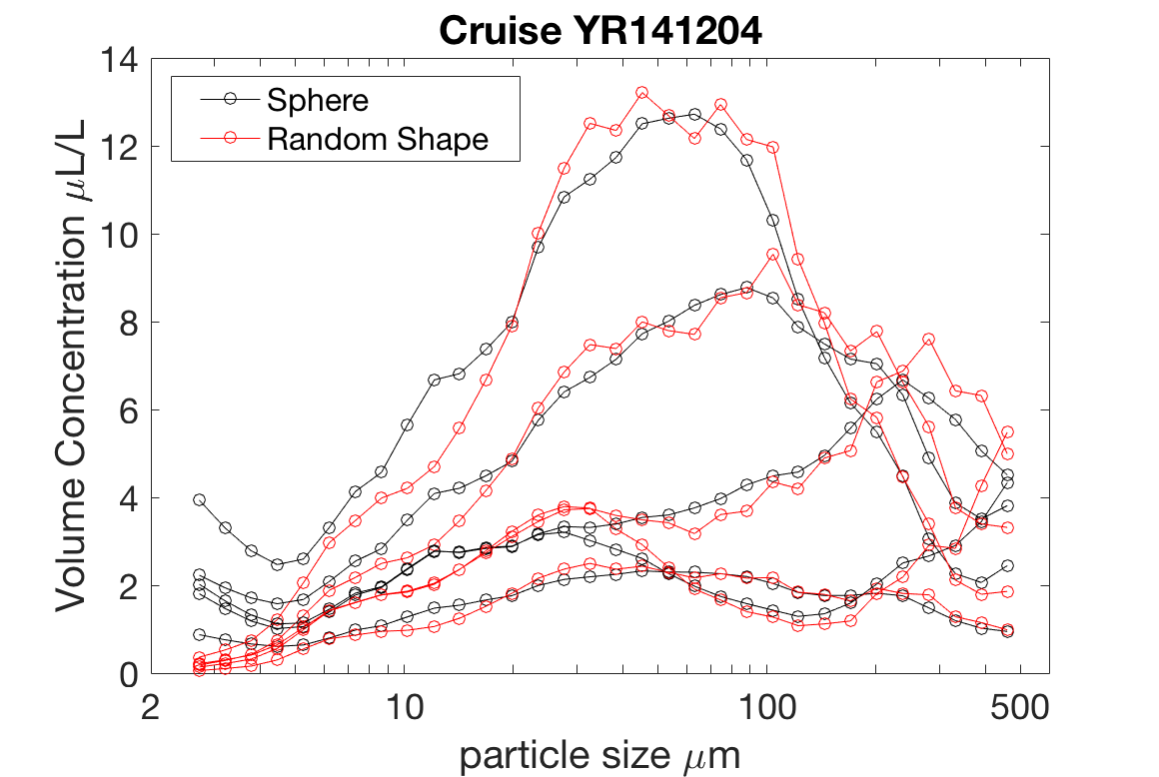
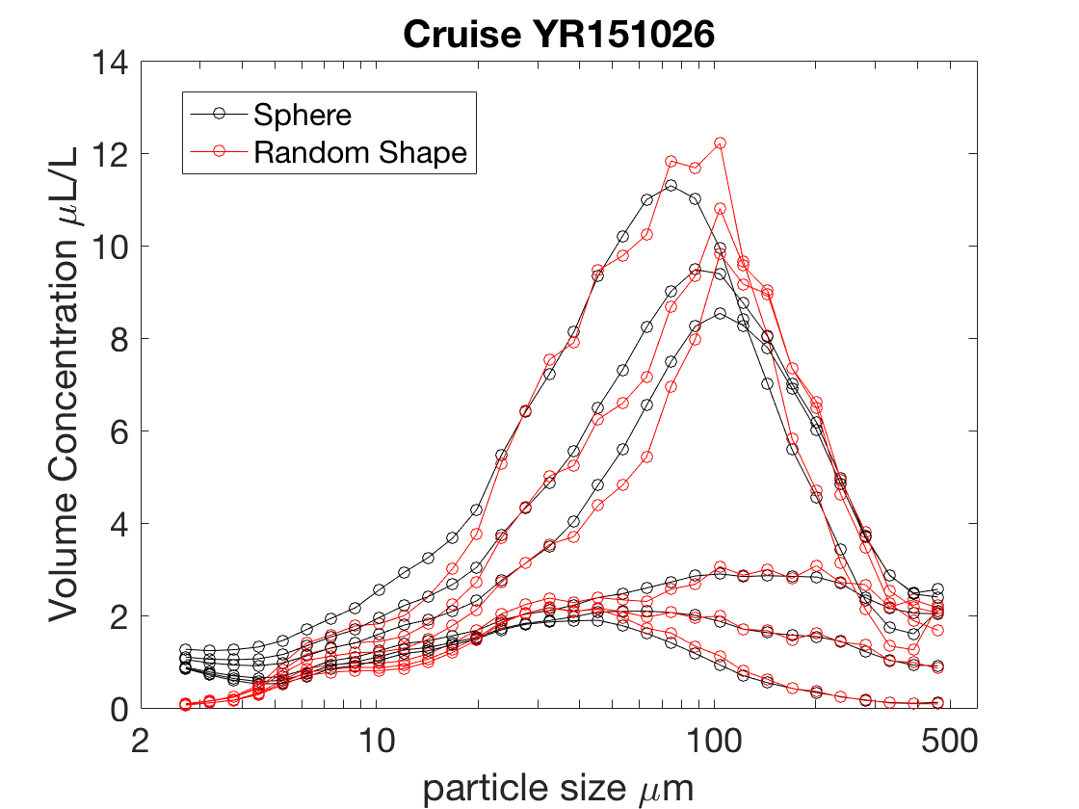
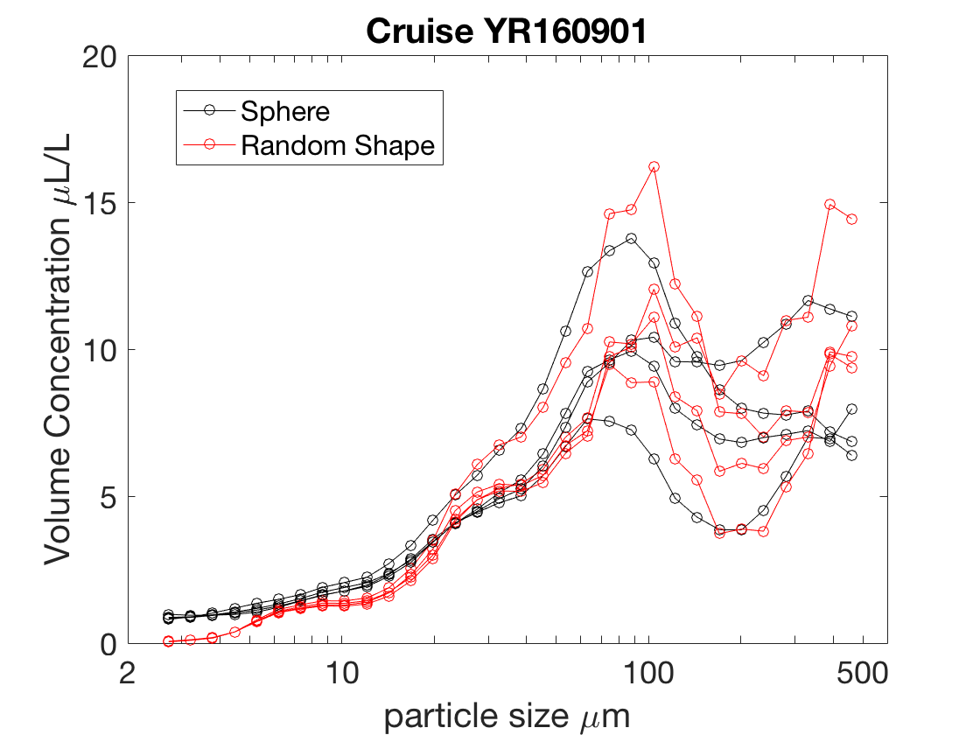
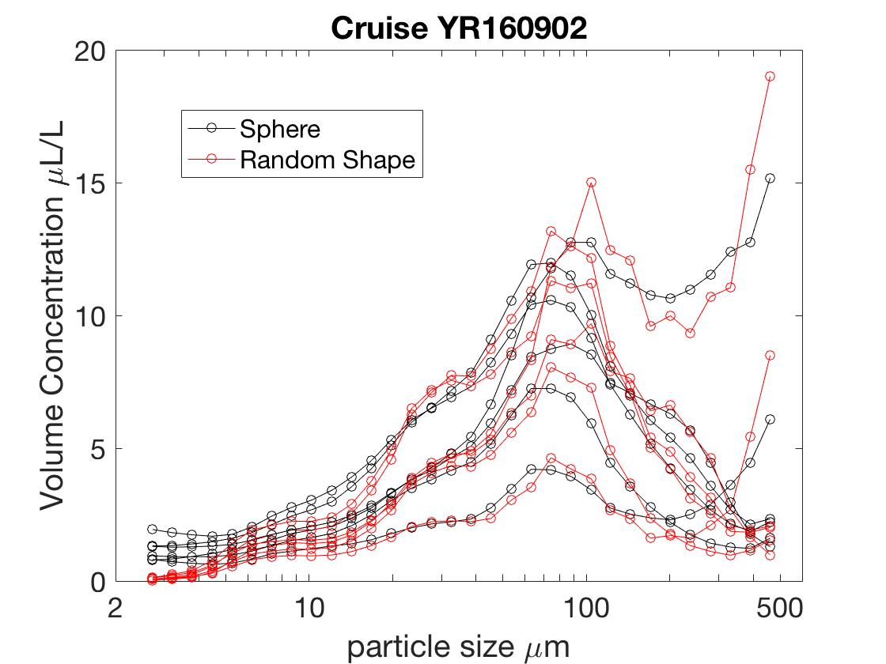
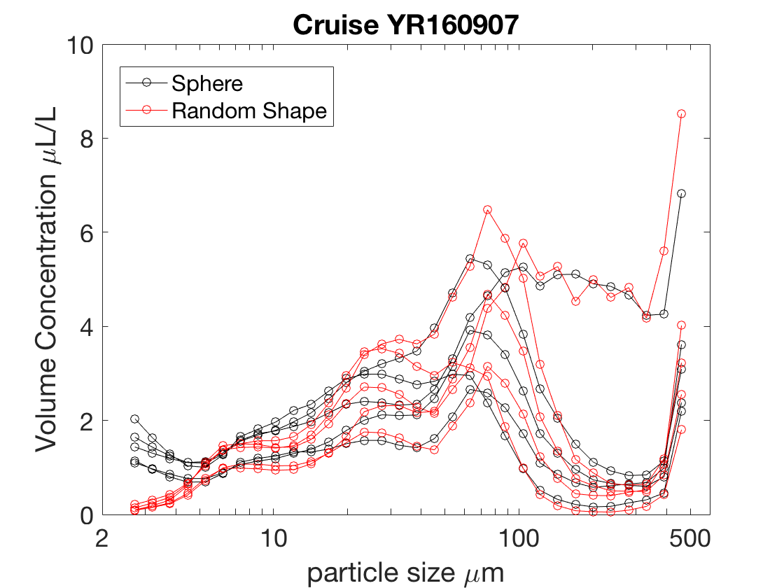
6/9 Cruises could be reprocessed using the random shape matrix

Slide 2
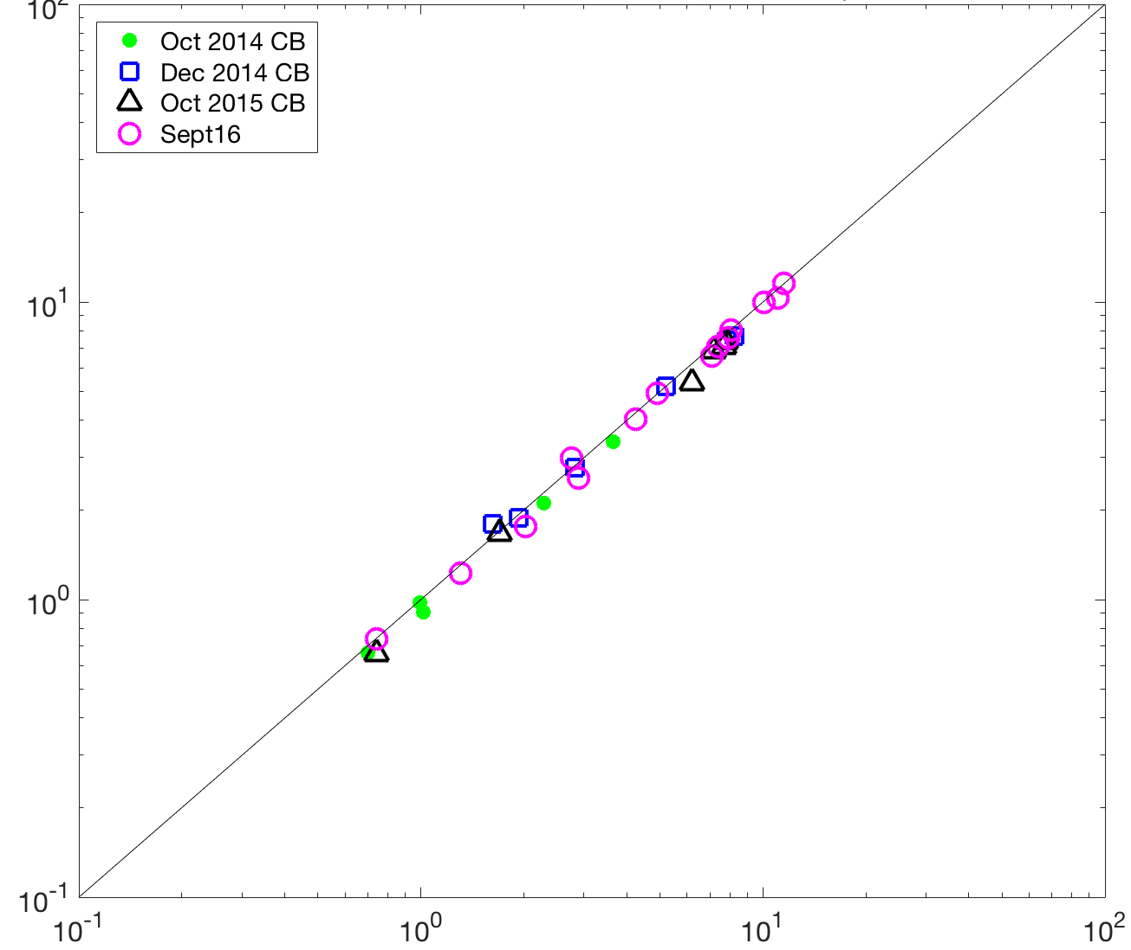
Mean LISST Volume Concentration from Spherical Inversion vs. Random Shape Inversion for size class bins with midpoint sizes of ~74-280 μm
100
Does not include September 2014 (do not have raw data files to process with Random Shape)
10
Sphere VC_{LISST} over 74-280 μm ( μL/L)
1
0.1
0.1 1 10 100
Random Shape VC_{LISST} over 74-280 μm ( μL/L)

Slide 3
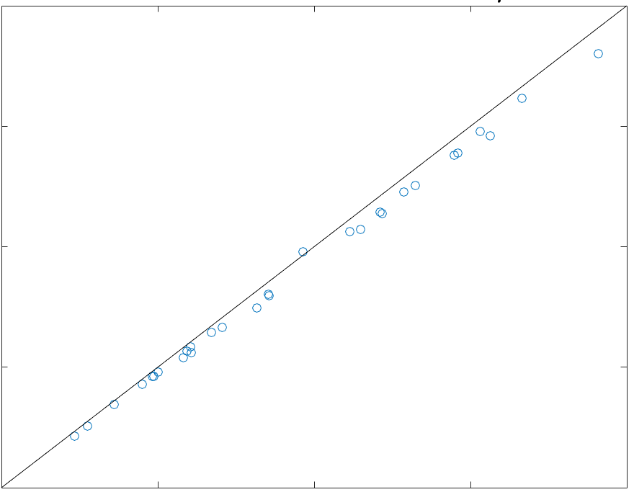
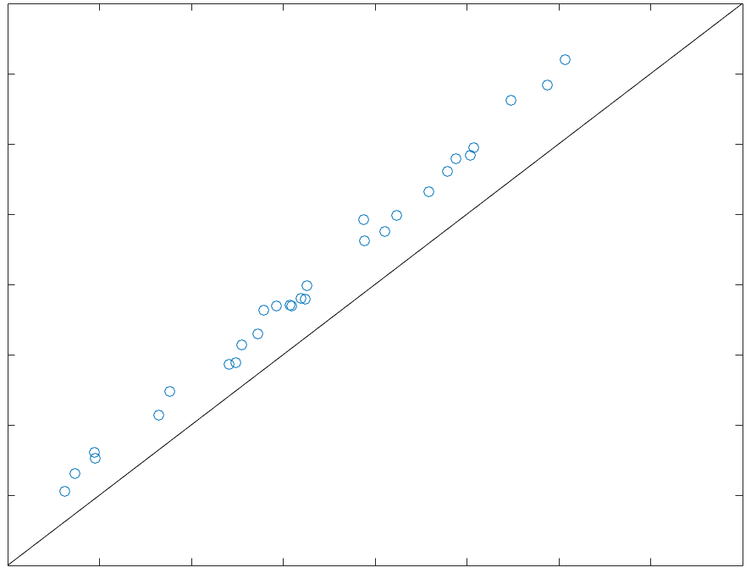
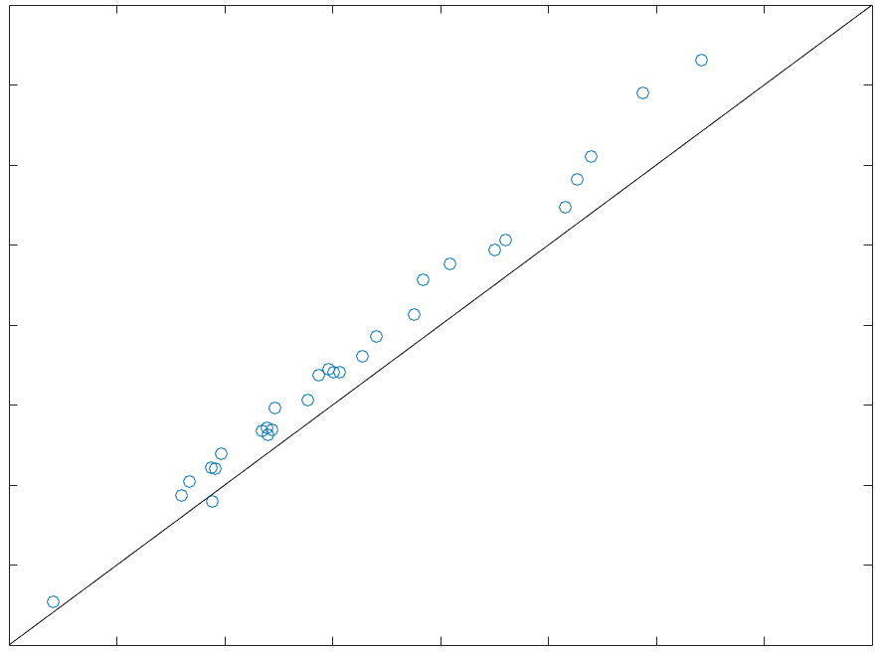
Compare total volume concentration (VC_{T}), median particle size (d_{50V}) and apparent density (ρ_{a})
Does not include September 2014 (do not have raw data files to process with Random Shape)
LISST Total Volume Concentration, VC_{T}, μL/L
LISST Median Particle size, d_{50V}, μm
200
100
150
80
Random Shape, VC_{T}, μL/L
Random Shape, d_{50V}, μm
100
60
50
40
20
50 100 150 200
20 40 60 80 100
Sphere, d_{50V}, μm
Sphere, VC_{T}, μL/L
LISST Apparent Density, ρ_{a}, kg/m³
600
500
400
Random Shape, ρ_{a}, kg/m³
300
200
200 300 400 500 600
Sphere, ρ_{a}, kg/m³

Slide 4
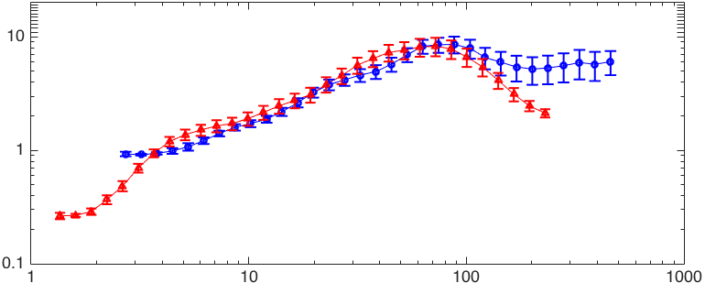
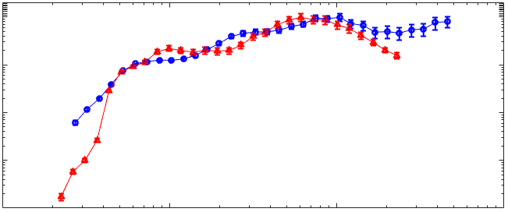
Sphere
Mean Volume Concentration Distribution from LISST100X Type B (Deployed) and Type C (Profiler) from September 2016
10
LISST Type B (Deployed)
LISST Type C (Profiler)
VC_{i} μL/L
1
0.1
10 100 1000
Floc Size μm
Random
Mean Volume Concentration Distribution from LISST100X Type B (Deployed) and Type C (Profiler) from September 2016
10
1
0.1
0.01
10 100 1000
Floc Size μm

